Slide 1

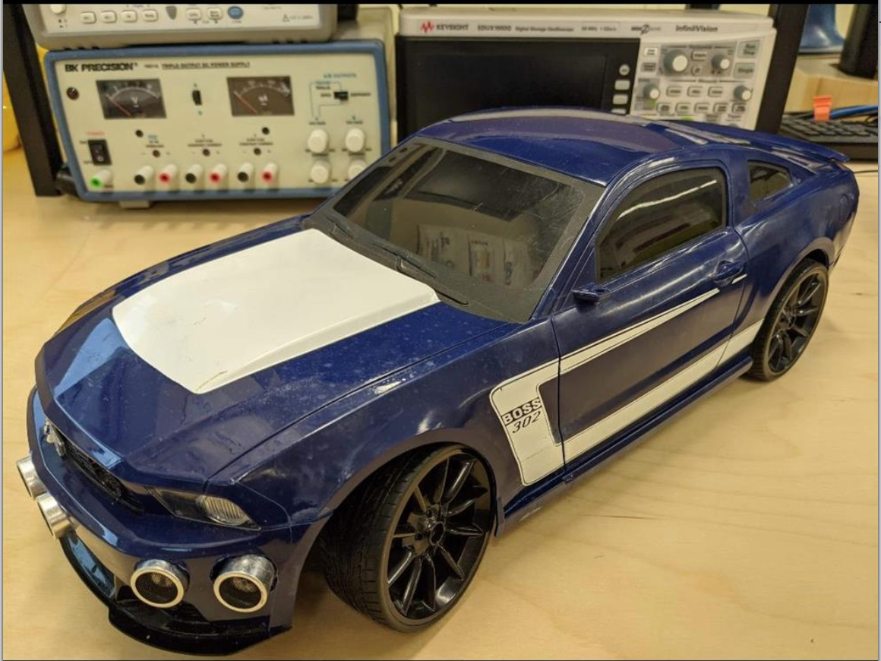
Dual Mode Robot By: Xuhua Huang, Liam O’Brien, Nasr Kharrat
The Dual Mode Robot is a remote-control car that can drive forwards, backwards, left and right. The user controls the robot via a Graphical User Interface on Windows. Using this software, the speed and turning radius can be controlled by the user, along with an emergency stop feature included and a feature that enables the vehicle to automatically avoid obstacles using sensors to prevent the vehicle from taking any damage from collisions.

